Slide 1
CHAPTER 1
APPLICATIONS OF INTEGRATION

Slide 2
CONTENTS
1.1. More about Areas
1.2. Volumes
1.3. Arc Length
1.4. Average Value of a Function
1.5. Applications to Physics & Engineering
1.6. Applications to Economics & Biology

Slide 3
1.3. ARC LENGTH
If the curve is a piecewise linear curve ( a polygonal line), we may define its length as
the sum of the lengths of the line segments (the sides of the polygonal line)
A
B
E
C
D

Slide 4
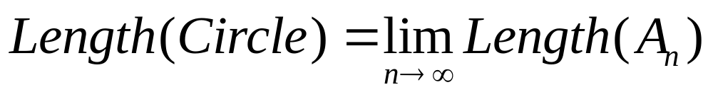
If the curve is not piecewise linear, e.g. a circle,
we may approximate its length by the length of the polygones inscribed in it.
Then we let the number of sides increase infinitely
A₁
A₂
A₃
A₄
A₅

Slide 5
In general let C be a curve described by the parametric equations
x = f(t), y=g(t) a ≤ t ≤ b
Let assume that C is smooth in the sense that the derivatives f '(t) and g '(t) are continuous and not simultaneously zero for a ≤ t ≤ b.
P₂
P₁
P_{n}
P₀
P_{n-1}
We divide [a, b] into n subintervals of equal width Δt with the endpoints t₀, t₁, t₂, …, t_{n},
then x_{i} = f(t_{i}), y_{i} = g(t_{i}) are coordinates of the points P_{i} = (x_{i}, y_{i}) lying on C.

Slide 6
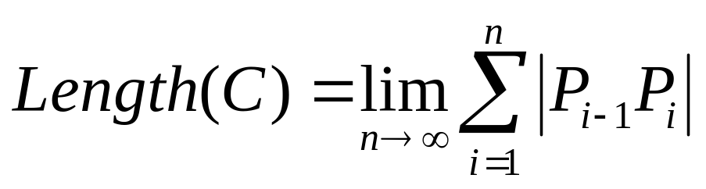
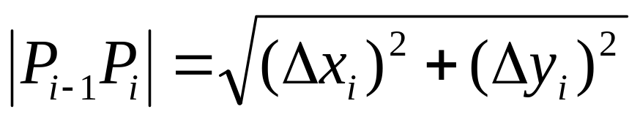
We approximate the length L of C by the length of the polygonal line P₀ P₁ P₂… P_{n}
Let Δx_{i} = x_{i} – x_{i-1} and Δy_{i} = y_{i} – y_{i-1} then the length of the line segment P_{i-1} P_{i} is
For Δt small we can approximate Δx_{i} and Δy_{i} by
Δx_{i} ≈ f '(t_{i}) Δt Δy_{i} ≈ g '(t_{i}) Δt

Slide 7
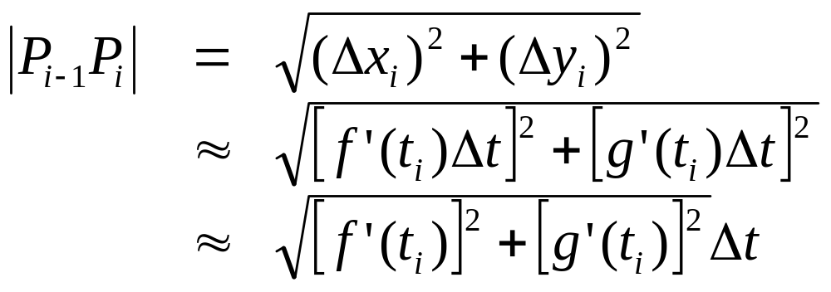
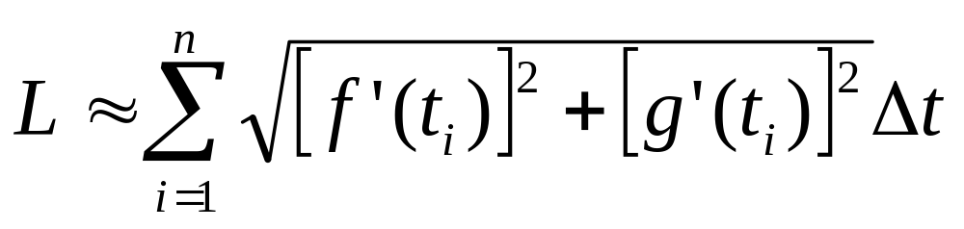
For Δt small we can approximate Δx_{i} and Δy_{i} by
Δx_{i} ≈ f '(t_{i}) Δt Δy_{i} ≈ g '(t_{i}) Δt
Hence
and
By passing to the limit we have

Slide 8
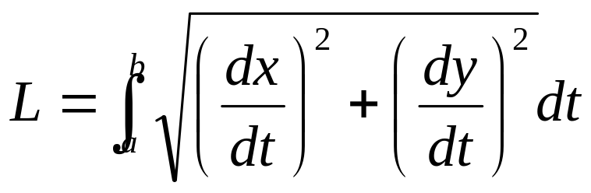
Arc Length Formula. Let C be a smooth curve with parametric equations x = f(t), y=g(t), a ≤ t ≤ b.
If C is traversed exactly once as t increase from a to b , then its length is

Slide 9
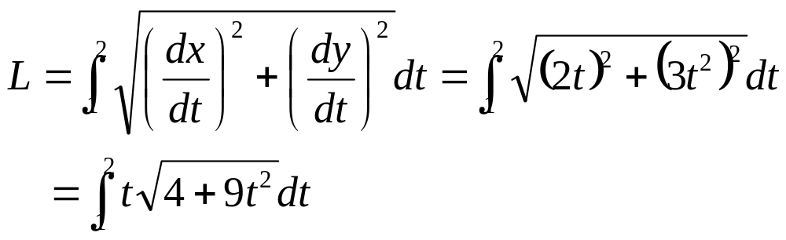
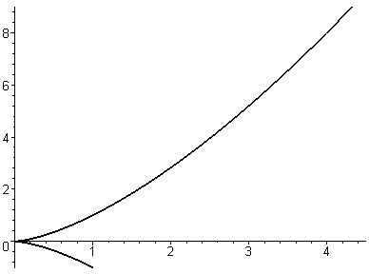
Example. Find the length of the arc of the curve x=t² y = t³ that lies between the points (1,1) and (4,8)
Solution. The points (1,1) and (4,8) correspond to the values of the parameter: t = 1 and t = 2. Hence
(4,8)
(1,1)

Slide 10
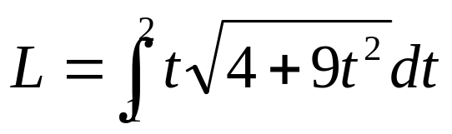
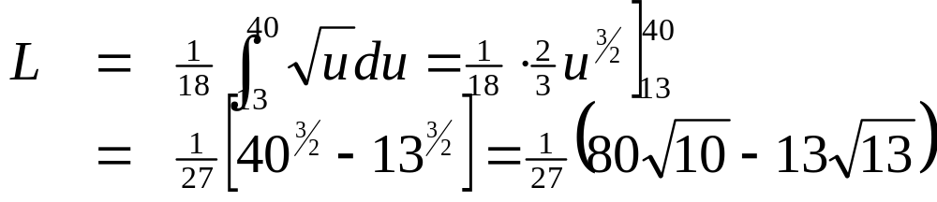
We make the substitution u=4+9t² then du=18tdt.
When t=1, u=13 and when t=2, u=40
Therefore

Slide 11
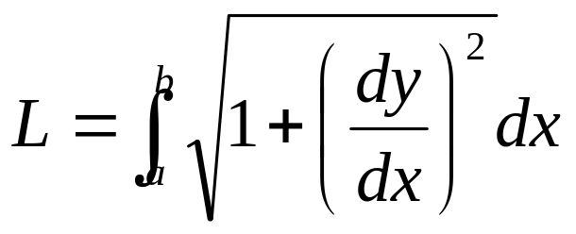
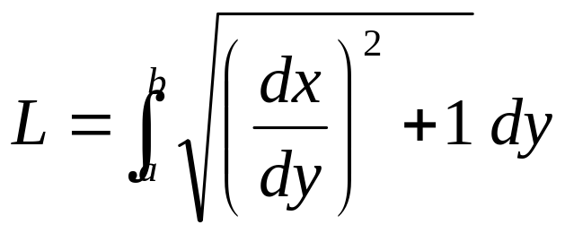
Note. If the curve is given by the equation y=f(x), a ≤ x ≤ b, then we can regard x as a parameter and the parametric equations are
x = x, y = f(x)
And the Arc Length Formula becomes
Similarly if the curve is given by the equation x=f(y), a ≤ y ≤ b, then y becomes the parameter and

Slide 12
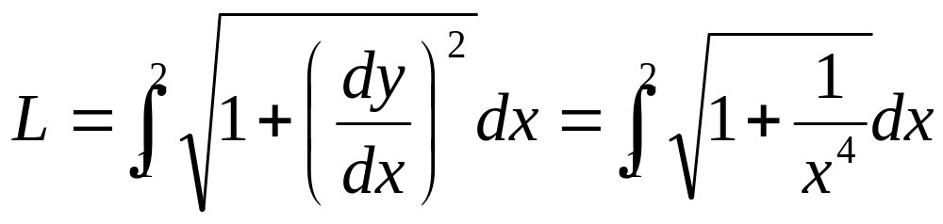
Note. Since there is a root sign in the Formula, the computation of the exact value of the arc length is difficult or even impossible
Example. Find the length of the portion of the hyperbola xy = 1 from (1,1) to (2, 1/2)
Solution. We have y = 1/x and dy/dx = -1/x². Hence
The integrand has no antiderivative expressible in terms of elementary functions, so we use Simpson's Rule to get an approximate value for the length

Slide 13
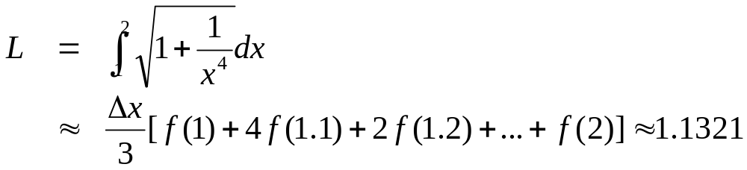
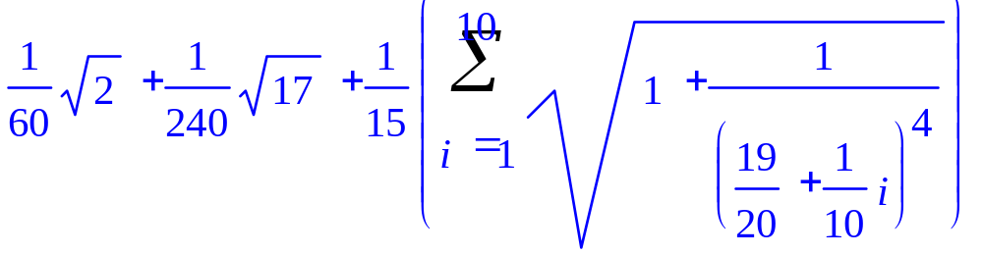
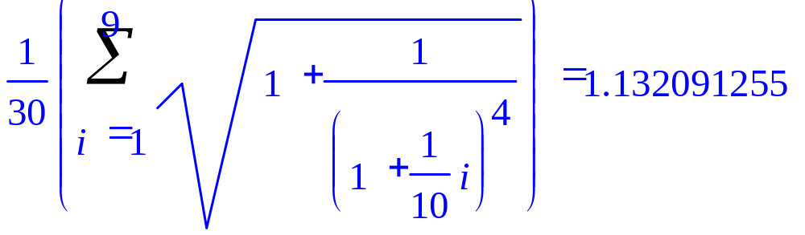
We take a=1, b=2, n=10 and Δx = 0.1
We can also use the MAPLE's command Simpson
+

Slide 14
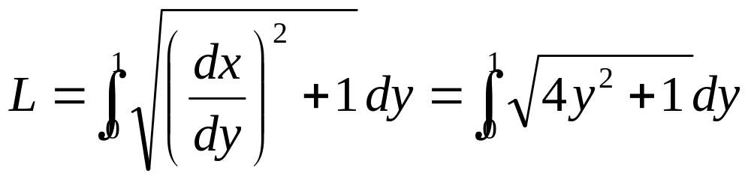
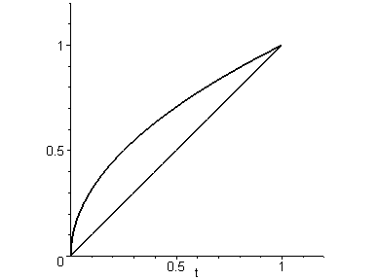
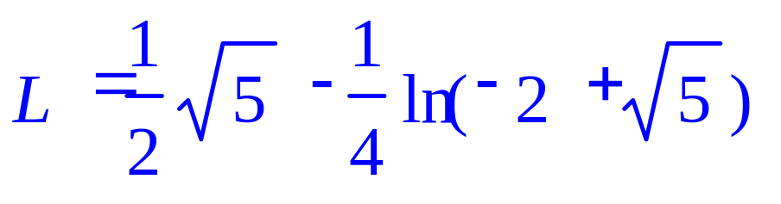
Example. Find the length of the arc of the parabola y² = x from (0, 0) to (1, 1)
Solution. We have x = y² and dx/dy = 2y. Hence
MAPLE's command int gives
x=y²

Slide 15
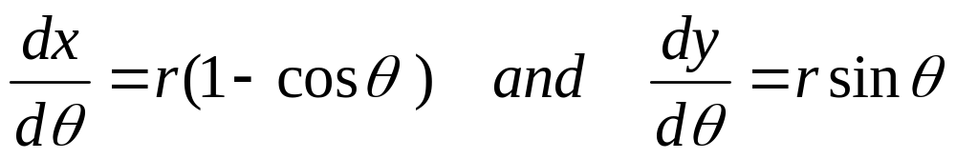
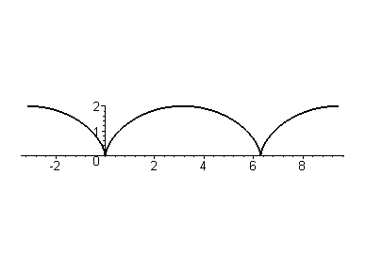
Example. Find the length of one arch of the cycloid x = r (θ –sinθ ) and y = r (1 – cosθ ) 0 ≤ θ ≤ 2π
Solution. We have

Slide 16
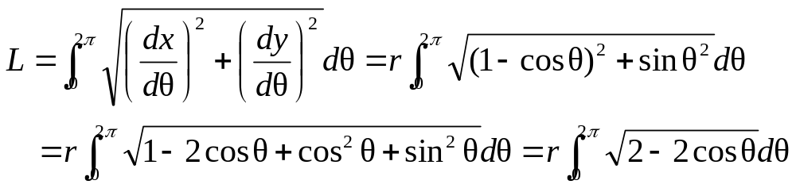
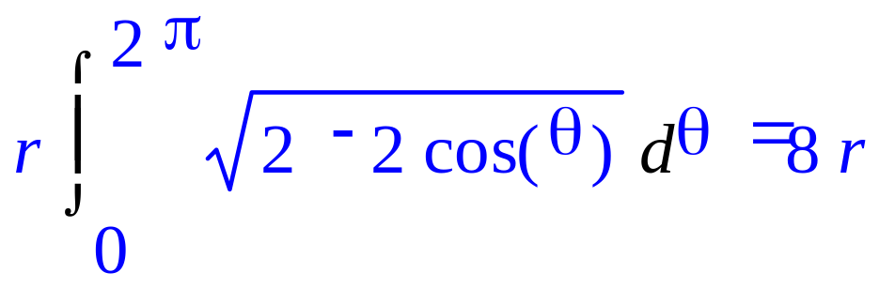
MAPLE's command int gives the value of L

Slide 17
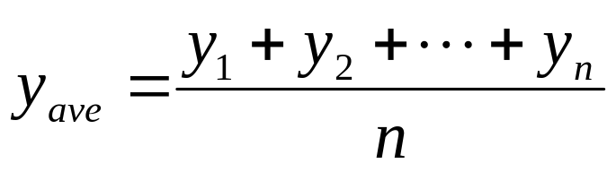
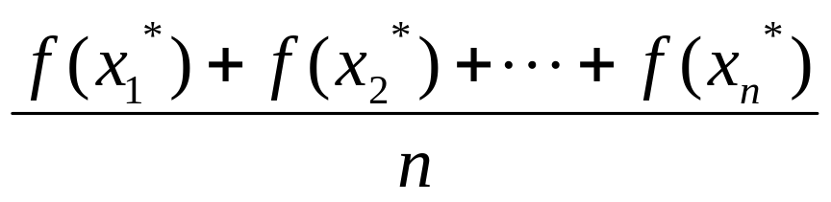
1.4. Average Value of a Function
The average value of finitely many numbers y₁, y₂, …, y_{n} is defined as
To compute the average value of infinitely many values such as those of a function f(x), a ≤ x ≤ b
we divide the interval [a, b] into n subintervals of equal length Δx,
and compute the average value of the sample points y₁*, y₂*, …, y_{n}* selected in these intervals

Slide 18
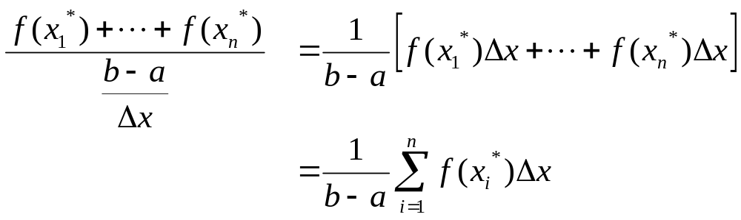
Substituting n=(b-a)/Δx in the above expression, we get

Slide 19
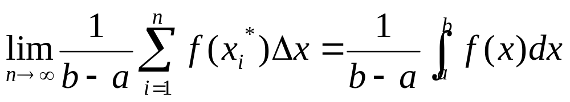
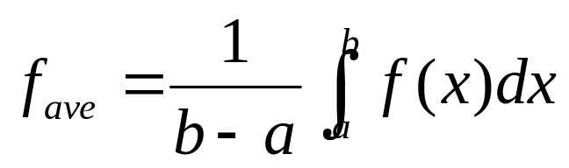
If we take sample values at a large number of points then the average value approaches a limiting value
Therefore the average value of a function f on the interval [a, b] is defined as

Slide 20
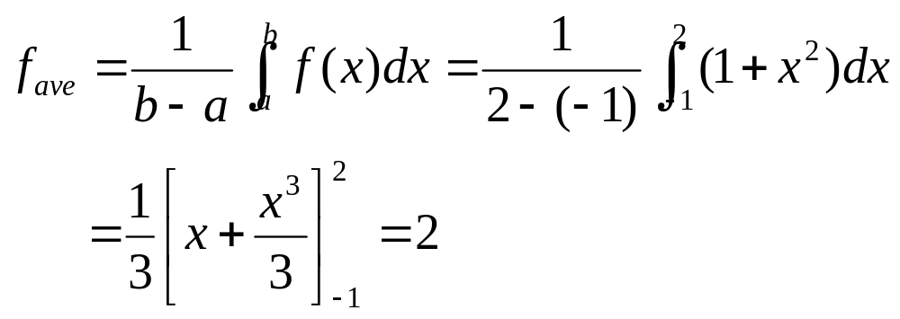
Example. Find the average value of the function f(x)=1+x² on the interval [-1, 2]
Solution. With a = -1 and b = 2 we have

Slide 21
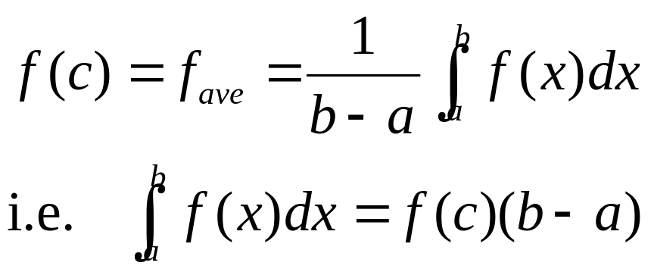
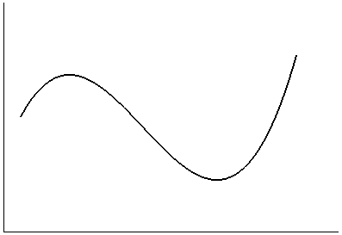
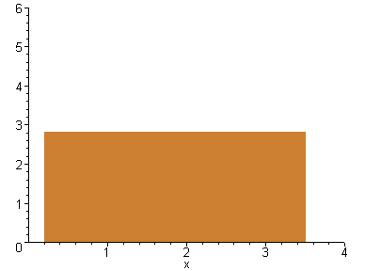
There is another question: where the function f attains its average value?
The Mean Value Theorem . If f is continuous on [a, b] then there exists a number c in [a, b] such that

Slide 22
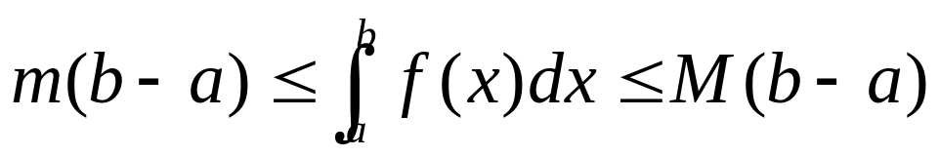
Proof . Let m and M be the minimum and maximum values of f on [a, b], then we have
i.e. m ≤ f_{ave} ≤ M
Since f is continuous on [a, b], there exists a number c in [a, b] such that :
f(c) = f_{ave}

Slide 23
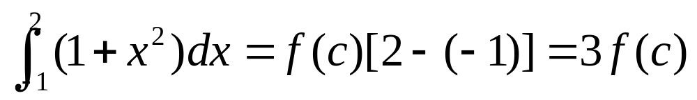
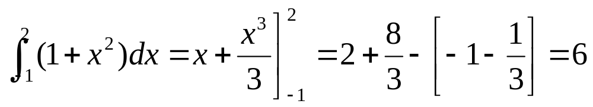
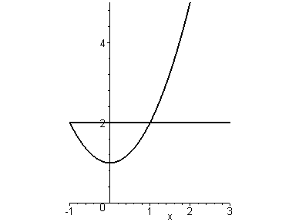
Example. Since f(x) = 1+x² is continuous on [–1, 2], there exists c in [–1, 2] such that
On the other hand
(2, 5)
Therefore: f(c) = 1 + c² = 2
i.e. c = ± 1
(–1, 2)

Slide 24
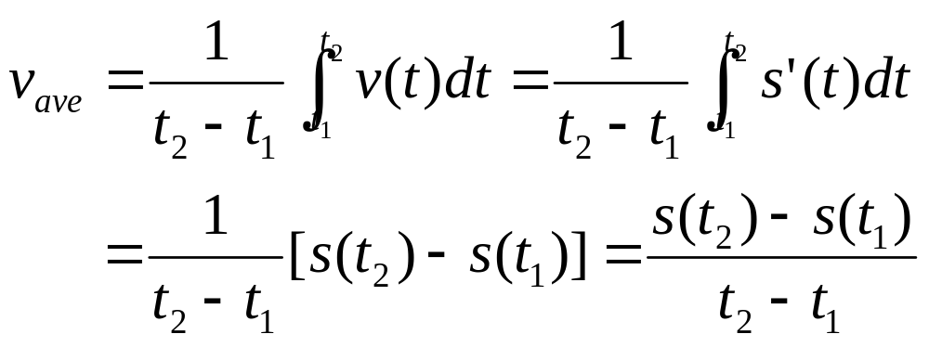
Example. Show that the average velocity of a car over a time interval [t₁, t₂] is the same as the average velocities during the trip
Solution. the average velocities during the trip is
The last expression is presisely the average velocity of the car over a time interval [t₁, t₂]

